Slide 1
Introduction to Health First History and Background
Broker Training
10142021

Slide 2
Module Description
This module is designed to:
Provide an overview of Health First facilities and systems.
Review where Health First Health Plans fits into the Health First corporate structure.
Review the Health First Integrated Delivery Network (IDN) and discuss available services.
Indicates clickable link to HFHP website

Slide 3
Vision
“Skilled and dedicated people
delivering high-quality, patient-centered care
that improves lives and communities.
Every person. Every time.”

Slide 4
Mission
“Our team positively improving the wellness and health of you and your family through excellent and compassionate healthcare.”

Slide 5
Timeline of Progress
Brevard Hospital becomes Holmes Regional Medical Center
Cape Canaveral Hospital opens
1937
1962
1992
1995
1996
1997
2011
2013
2014
2019
2021
All three hospitals joined to form Health First
Health First Health Plans and Oscar Health sign an Administrative Services Agreement
Health First Health Plans and Florida Hospital create a partnership
Brevard Hospital opens in Melbourne with 27 beds
Palm Bay Hospital opens
Viera Hospital opens
Health First Health Plans offers Brevard County Group Insurance
Health First Health Plans offers Individual Insurance
Florida Hospital Care Advantage Plans name change to AdventHealth Advantage Plans
Health First Health Plans offers Medicare Insurance

Slide 6
The Integrated Delivery Network
Our IDN encompasses Wellness and Prevention, community-based care, access to a physician group and hospital care
With the strength of the Health First IDN, Health First Health Plans is uniquely positioned to meet the healthcare needs of our community

Slide 7
Health First’s Role in the IDN
Population Health
Care that occurs to increase the level of wellness for our community
Provider Community
Our relationship with providers both employed and partnered with Health First
Outpatient and Wellness
Care that occurs in the community before, after or instead of hospital care (such as home care, ambulatory or outpatient surgery, outpatient diagnostics and hospice that provides dignified end-of-life services)
Acute Care
Those times when care is needed in one of our four Health First hospitals (Cape Canaveral Hospital, Holmes Regional Medical Center, Palm Bay Hospital and Viera Hospital)

Slide 8
Health First is not-for-profit.
What does this mean for our community?
Not-for-Profit/Community-Minded | For Profit/Investor-Owned
Assets stay in the community. | Assets belong to investors/owners.
Local board of trustees serves without pay and balances financial decisions with community concerns. | Major decisions are often made by individuals outside the community, who emphasize creating profits for stockholders.
Not for “private” profit; no private person or corporation makes any profit. | Stockholders might be physicians who practice at the hospital; community members are generally not allowed to purchase stock.
All income above expenses is used to improve the health of the community. | Profits often leave the community.
Provides a full spectrum of care – education, prevention and treatment – that benefits all members of the community. | Provides a full range of care that benefits the community they serve, however, focus is also placed on how to best serve their investors.

Slide 9
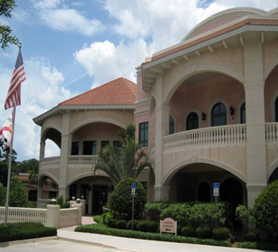
Health First Health Plans
Beginning Plan year 2022 Plan types offered include:
Medicare Advantage
Individual and Family

Slide 10
Medical Group
In 2013, Health First Physicians and Melbourne Internal Medicine Associates (MIMA) joined to form Health First Medical Group creating Brevard’s largest multispecialty physician group with more than 230 employed physicians

Slide 11
Wound Care and Hyperbaric
Provides Individualized treatment programs through a multidisciplinary medical team.
Local independent physicians specializing in:
Podiatry
Vascular surgeons
Internal medicine
General surgery
Infectious disease

Slide 12
Medical Rehabilitation
Provides physical therapy and medical rehabilitation services to patients on the Space Coast who are hospitalized, as well as on an outpatient basis.
Working together with primary care physicians, specialists, pediatricians and occupational medicine physicians, as well as employers and insurance providers.
Our goal is to restore patients to their best possible health and promote a healthy and safe lifestyle.
Locations: Melbourne | Merritt Island | Palm Bay | Viera

Slide 13
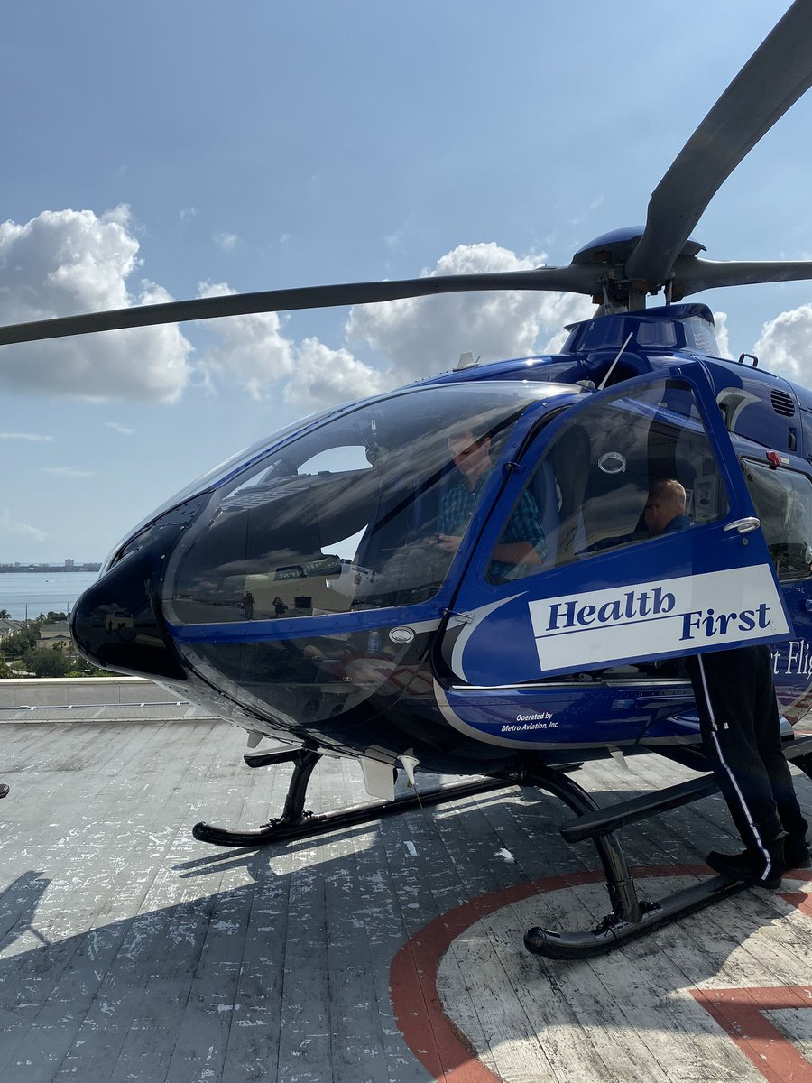
First Flight Air Ambulance
First Flight, Brevard’s only air ambulance, serving East Central Florida since 1988. Based at Health First’s Holmes Regional Medical Center & Trauma Center, First Flight is at work saving lives every day.
The helicopter serves Brevard, Indian River, and portions of Osceola and Orange counties

Slide 14
Aging Services
At Health First Aging Services, we are focused on addressing wellness in aging, along with managing the challenges and impairments some older adults experience.
Initiated in 2002, these services provide a comprehensive network of care and outreach for seniors and their caregivers.
Location: Melbourne

Slide 15
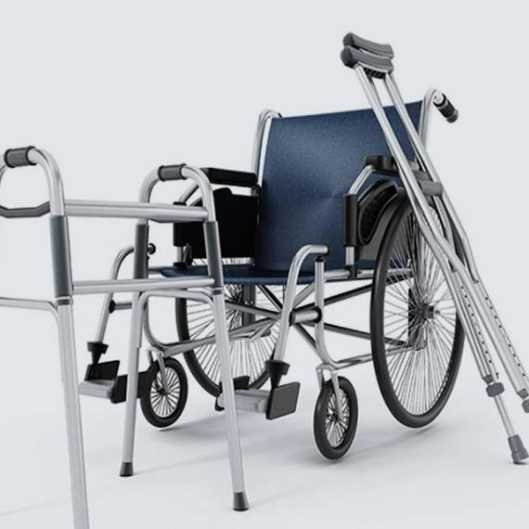
Medical Equipment
Respiratory care products
Hospital room setups for the home
Walkers
Wheelchairs
Lift chairs

Slide 16
Hospice
For more than 35 years, Hospice of Health First has been Brevard County’s leading provider of compassionate and skilled hospice care.
We focus on improving the quality of life for families dealing with a loved one’s end-of-life illness, making every remaining moment as comfortable, pain-free and meaningful as possible, for every person involved.

Slide 17
Family Pharmacy
Prescription mail-order program
Discounts for Health First Health Plans/AdventHealth Advantage Plans members
Infusion services
Our professional team includes experienced pharmacists who are supported by trained pharmacy technicians, all working together to ensure your safety and a positive experience.
Locations: Holmes Regional Medical Center | Health First Medical Group – Gateway | Viera Hospital

Slide 18
Home Care
Care consists of short-term assistance following a hospitalization, outpatient surgery, maternity-related incapacity, illness or injury that affects an individual's ability to leave home to get treatment.
Services Include:
Skilled nursing care
Wound care
Ostomy care
Respiratory care and tracheostomy care
Physical, Occupational and Speech Therapy

Slide 19
Sleep Centers
Health First Sleep Center is the only hospital-based American Academy of Sleep Medicine (AASM)-accredited sleep center in Brevard County.
Our professional team is made up of board-certified physicians.
Locations: Cocoa Beach | Palm Bay | Viera

Slide 20
Health First | AdventHealth Centra Care
Focuses on:
Delivering high-quality compassionate medical care in state-of-the-art facilities
Providing treatments that are non-life-threatening injuries or illness
Locations: Cocoa Beach | Malabar | Melbourne | Titusville

Slide 21
Pain Management
We provide customized complementary alternatives to help patients cope with pain, which allows them to benefit more from the traditional medical therapies that their primary doctors provide.
Locations: Cocoa Beach | Palm Bay

Slide 22
Breast Center
The Health First Breast Center uses advanced technologies and treatments, ensuring our patients a comprehensive, timely and personalized approach to breast care.
3D imaging improves detection of invasive cancers and reduces false positives
Nurse navigators help patients every step of the way
Reduced wait times for results
Calm, comfortable atmosphere
Location: Health First Medical Group – Gateway

Slide 23
Thank You!

